Slide 1
Exploring Alternative Databases
Anthony Arroyo
Data Structures
Scalability
Consistent or Available?

Slide 2



Traditional Databases
Atomic
Consistent
Isolated
Durable

Slide 3

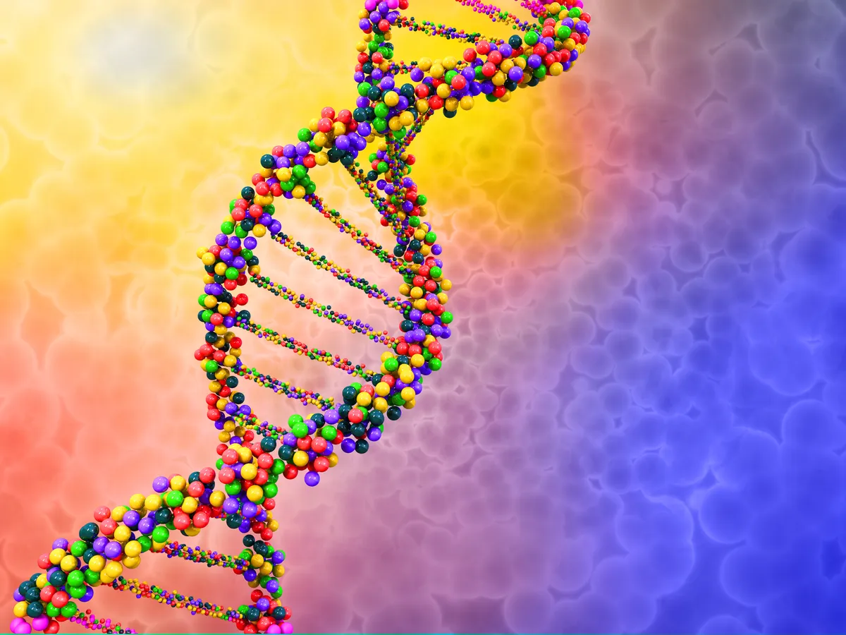

New Generation Databases
Basic
Availability
Soft-state
Eventual consistency

Slide 4
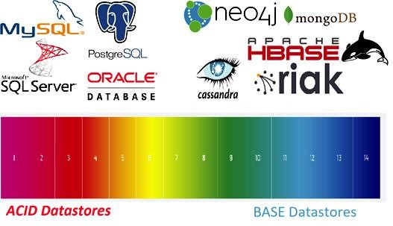
Technologies
https://www.gavstech.com/the-shifting-ph-of-databases-from-acid-to-base/

Slide 5
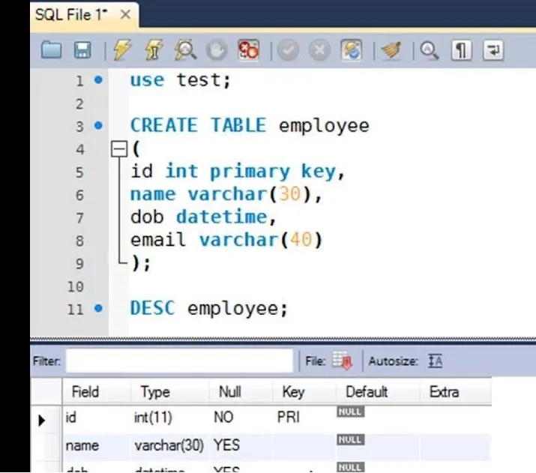
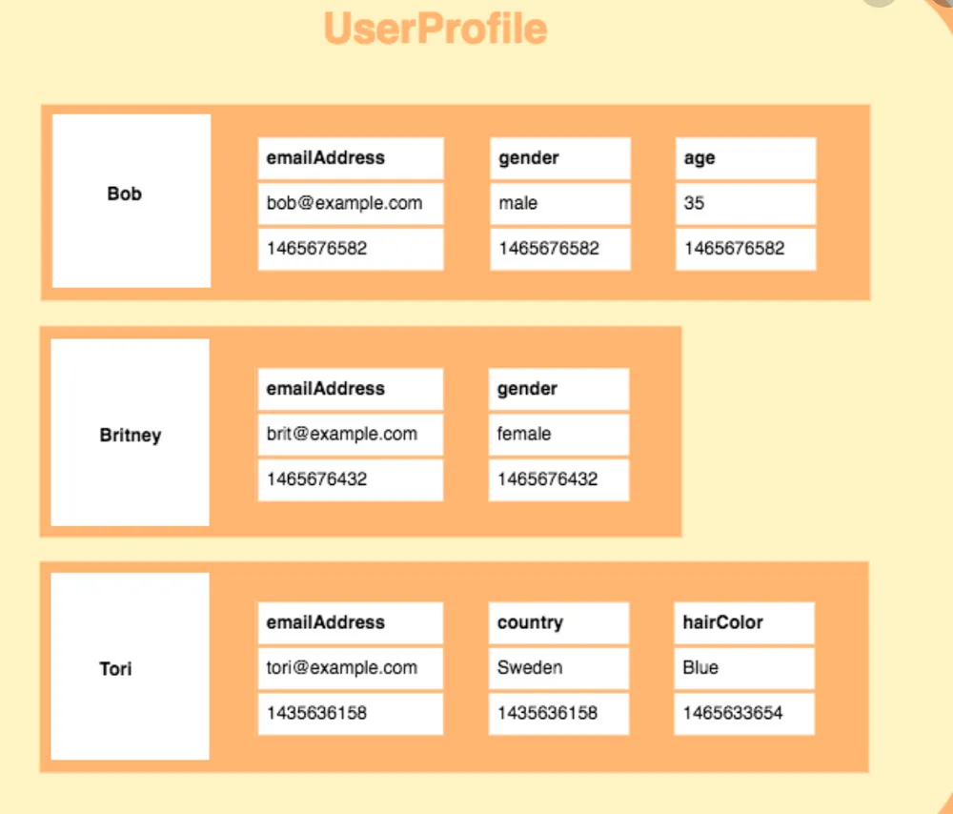
Tables vs Dictionaries

Slide 6
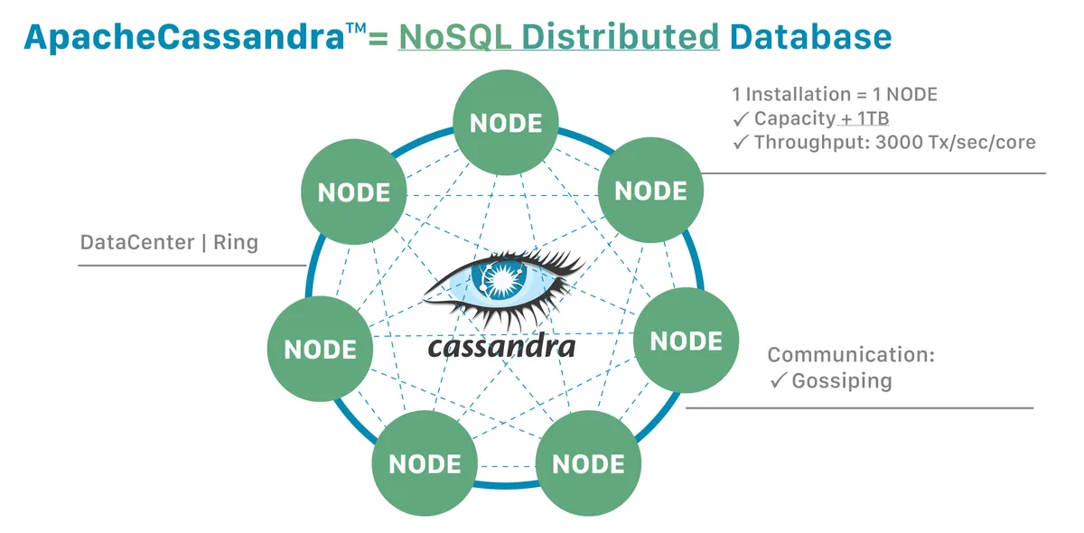
Highly Scalable, Fault Tolerant
https://www.baeldung.com/cassandra-keys

Slide 7
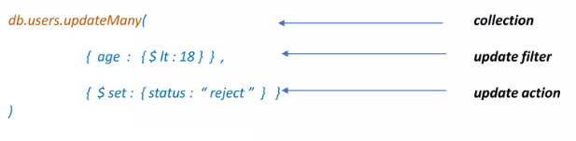
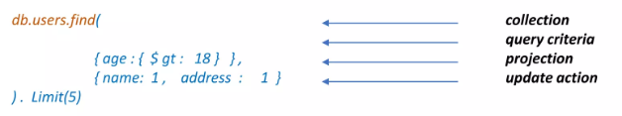
Non-Relational Operations
Create
Update
Read
Delete
https://www.slideshare.net/HyphenCall/mongodb-presentation-94366446

Slide 8
